Slide 1
Arbitrage Part 2
23-Oct-2017 10:00pm hingga 10:30 pm

Slide 2
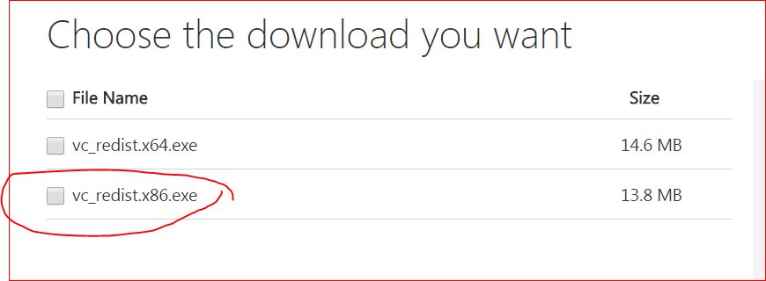
ZeroMQ
Microsoft Visual C++ 2015 Redistributable Update 3
https://www.microsoft.com/en-us/download/details.aspx?id=53840

Slide 3
Python
Python for window 2.7
Zmq module
Pip install zmq

Slide 4
Q and A

